Slide 1
Cognitive Psychology
WEEK 3
BY:AQSA FAYYAZ
LECTURER PSYCHOLOGY
(SCIENCE AND HUMANITIES)

Slide 2
COURSE OBJECTIVES
Students will get a deeper understanding about internal mental processes.
Students would be able to learn ways to improve memory.

Slide 3
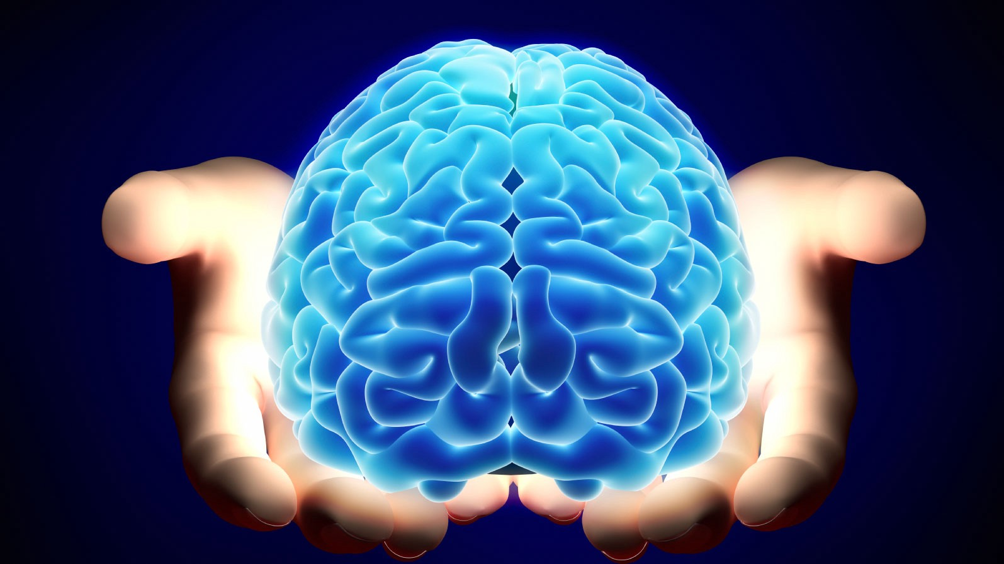
Cognitive Psychology
Sternberg (1999) defined Cognitive psychology as that which deals with “how people perceive, learn, remember, and think about information.”
In general, Cognitive psychology can thus be defined as that branch of psychology that is concerned with how people acquire, store, transform, use and communicate language.
All of the things that go on inside your brain-internal mental processes.

Slide 4
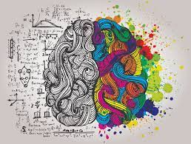
Cognition
The word ‘cognition’ is derived from the Latin word, meaning “to know” or “to come to know”.
In other words, it might include the processes that help us to perceive, attend, remember, think, categorize, reason, decide, and so on.

Slide 5

History of Cognitive Psychology
Cognitive psychology became more predominant during the period between the 1950s and 1970s. Prior to this time, behaviorism was the dominant perspective in psychology, but researchers began to grow more interested in the internal processes that affect behavior instead of just the behavior itself.
In 1967, the psychologist Ulric Neisser introduced the term cognitive psychology, which he defined as the study of the processes behind the perception, transformation, storage, and recovery of information.

Slide 6
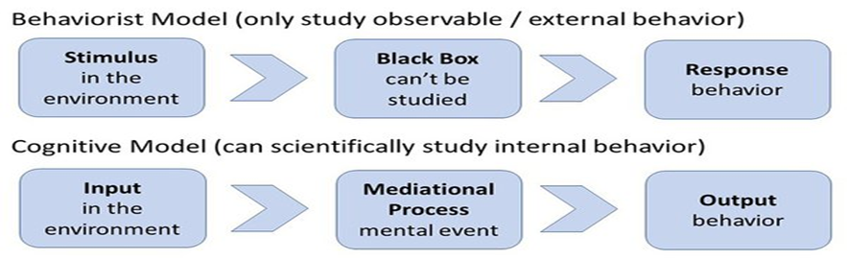
Mediational Processes
The behaviorists approach only studies external observable (stimulus and response) behavior which can be objectively measured. In comparison, the cognitive approach believes that internal mental behavior can be scientifically studied using experiments.
Cognitive psychology assumes that a mediational process occurs between stimulus/input and response/output. The mediational (i.e. mental) event could be memory, perception, attention or problem solving etc. These are known as mediational processes because they mediate (i.e. go-between) between the stimulus and the response.

Slide 7
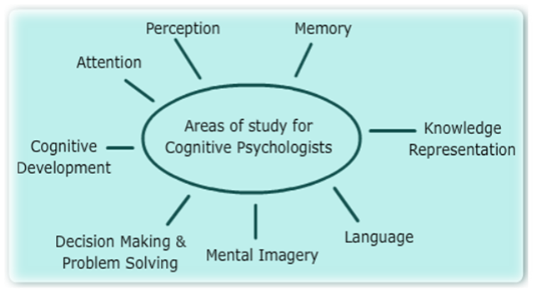
The cognitive psychologists study the various cognitive processes that make up this branch.

Slide 8
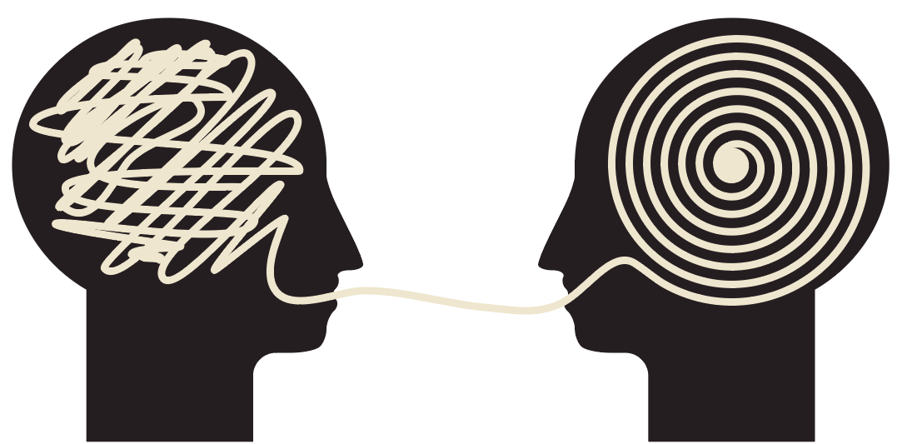
Cognitive Processes
There are many different types of cognitive processes. These include:
Attention: Attention is a cognitive process that allows people to focus on a specific stimulus in the environment.
Language: Language and language development are cognitive processes that involve the ability to understand and express thoughts through spoken and written words. It allows us to communicate with others and plays an important role in thought.
Learning: requires cognitive processes involved in taking in new things, synthesizing information, and integrating it with prior knowledge.

Slide 9
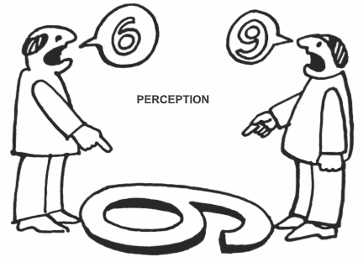

Memory: Memory is an important cognitive process that allows people to encode, store, and retrieve information. It is a critical component in the learning process and allows people to retain knowledge about the world and their personal histories.
Perception: Perception is a cognitive process that allows people to take in information through their senses (sensation) and then utilize this information to respond and interact with the world.
Thought: Thought is an essential part of every cognitive process. It allows people to engage in decision-making, problem-solving, and higher reasoning.

Slide 10
Two important Cognitive Psychology Theories
Jean Piaget's theory of cognitive development
Lev Vygotsky's social cultural cognitive theory

Slide 11
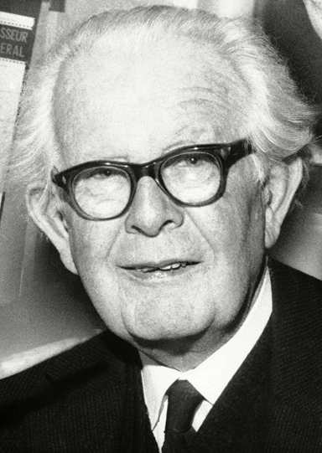
Piaget's theory of Cognitive Development
Jean Piaget (1896-1980) was one of the 20th century's most influential researchers in the area of developmental psychology.
His theory focuses not only on understanding how children acquire knowledge, but also on understanding the nature of intelligence.
Piaget studied Cognitive Development by observing children in particular, to examine how their thought processes changed with age.
Cognitive Development
Cognitive Development is the emergence of the ability to think and understand.
The acquisition of the ability to think, reason and problem solve. It is the process by which people's thinking changes across the life span.
It is the growing adaptation to the physical and social environment.

Slide 12
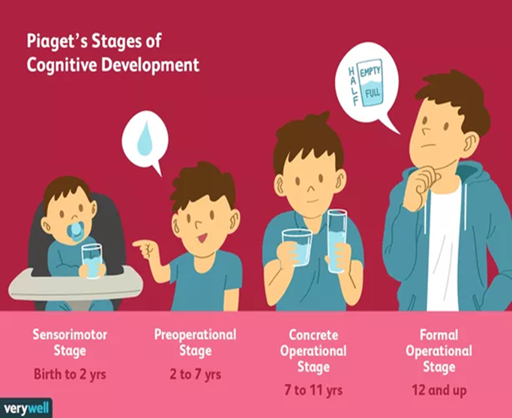
https://www.youtube.com/watch?v=IhcgYgx7aAA

Slide 13


1.The Sensorimotor Stage
Ages: Birth to 2 Years
The infant knows the world through their movements and sensations
Children learn about the world through basic actions such as sucking, grasping, looking, and listening
They realize that their actions can cause things to happen in the world around them.
With time Infants learn that things continue to exist even though they cannot be seen (object permanence).

Slide 14


Slide 15

2.The Preoperational Stage
Ages: 2 to 7 Years
Children begin to think symbolically and learn to use words and pictures to represent objects.
Children at this stage tend to be egocentric and struggle to see things from the perspective of others.
While they are getting better with language and thinking, they still tend to think about things in very concrete terms.

Slide 17
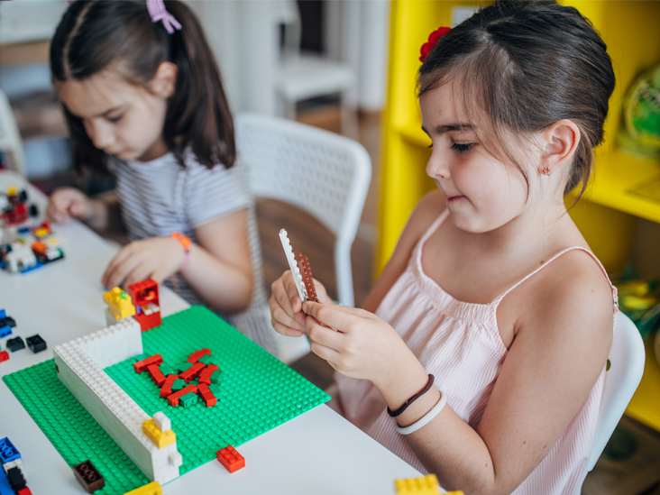
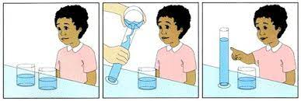
3.The Concrete Operational Stage
Ages: 7 to 11 Years:
During this stage, children begin to thinking logically about concrete events
They begin to understand the concept of Conservation which is the understanding that something stays the same in quantity even though its appearance changes
for example: that the amount of liquid in a short, wide cup is equal to that in a tall, skinny glass,.
Their thinking becomes more logical and organized, but still very concrete

Slide 18
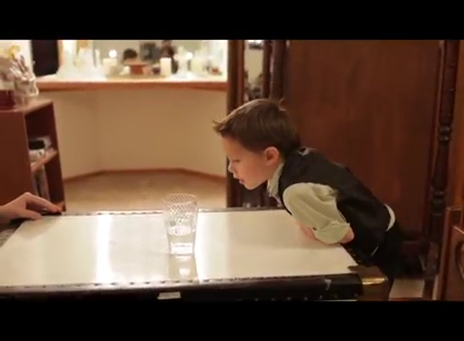

Slide 19
4. Formal Operational stage
11years onward:
This is the highest level of thinking stage and child is capable of going beyond
the concrete evidence. The learner at this stage is able to concentrate their thoughts on things that have no existence
Create hypothesis and test them
Notes:
https://www.researchgate.net/publication/265916960_THE_PIAGET_THEORY_OF_COGNITIVE_DEVELOPMENT_AN_EDUCATIONAL_IMPLICATIONS

Slide 20
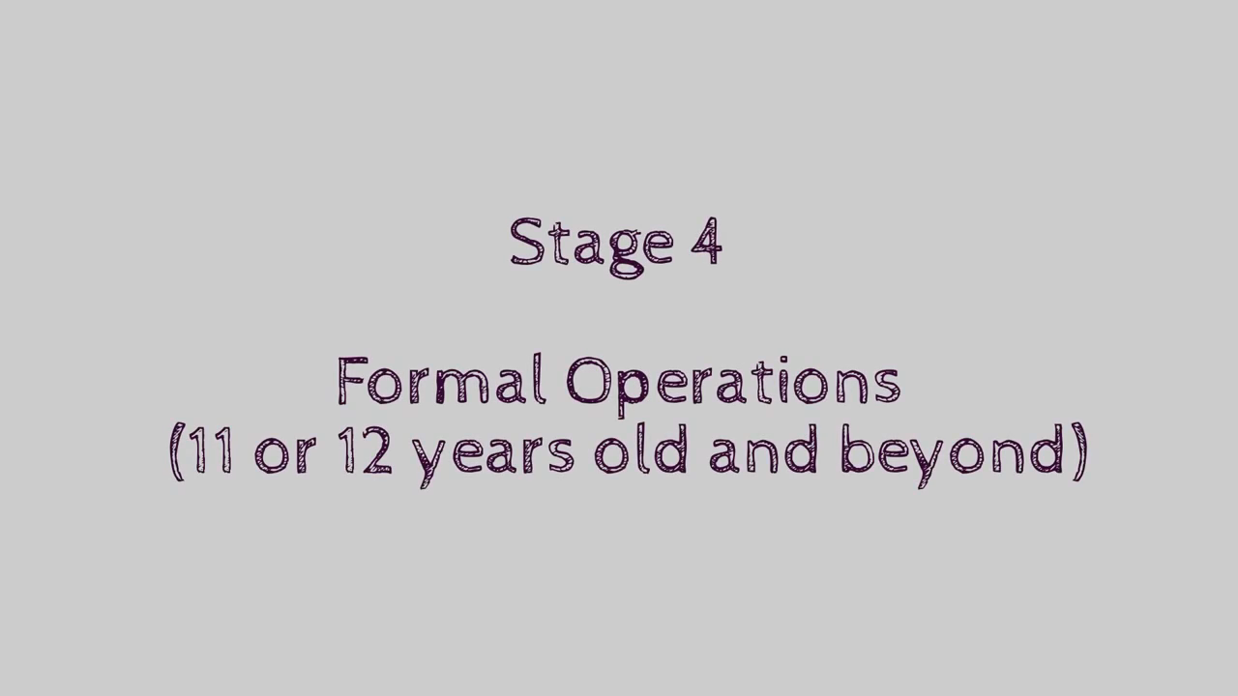

Slide 21
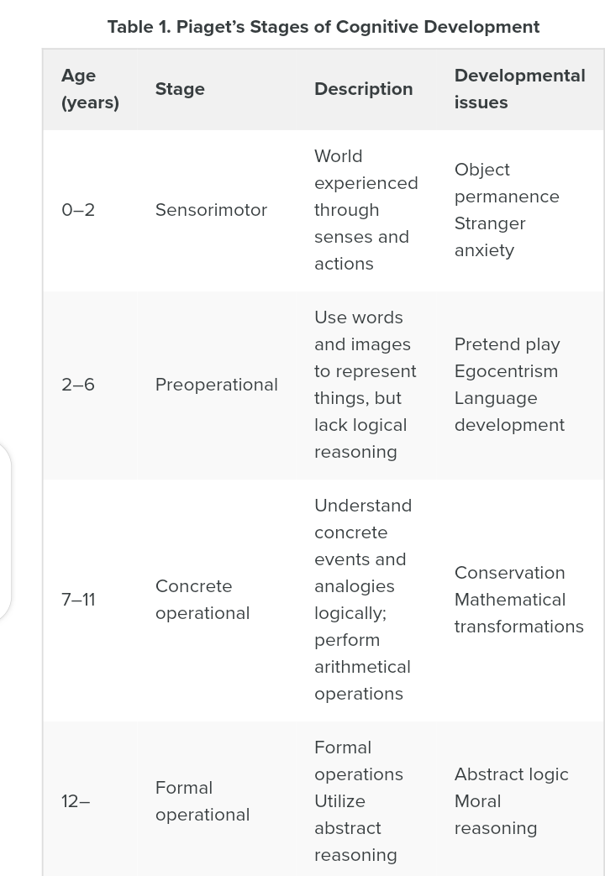

Slide 22
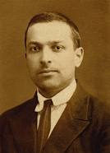
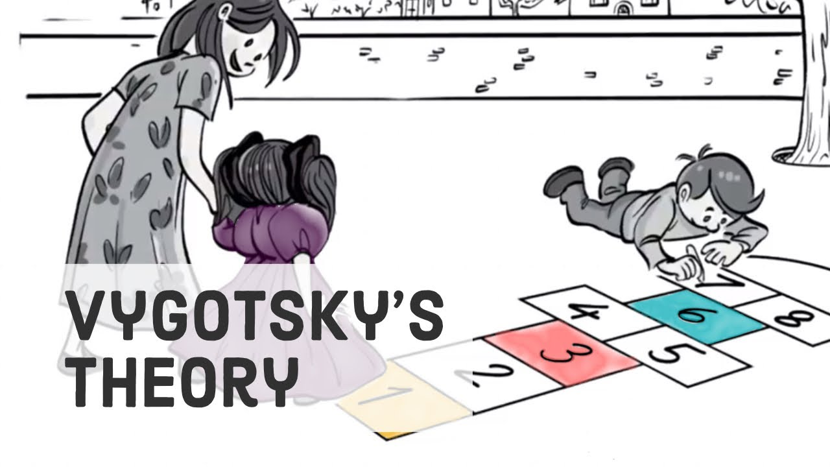
Lev Vygotsky's Social Cultural Cognitive Theory
Vygotsky's theory revolves around the idea that social interaction is central to learning.
Vygotsky's sociocultural theory asserts that learning is an essentially social process in which the support of parents, caregivers, peers and the wider society and culture plays a crucial role in the development of higher psychological functions.
Vygotsky’s concept of Zone of Proximal Development underscores Vygotsky’s conviction that social influences, particularly getting instructions from someone are of immense importance on the cognitive development in early childhood.
Lev Semyonovich Vygotsky was a Soviet psychologist, known for his work on psychological development in children.

Slide 23
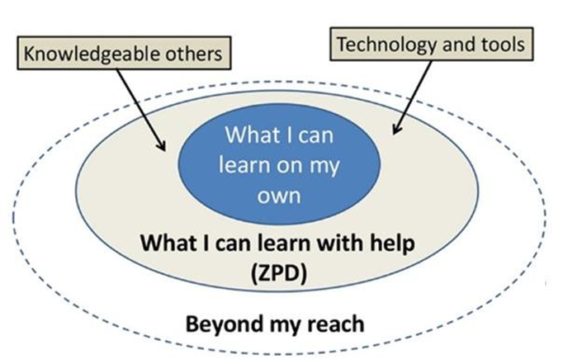

Vygotsky’s concept of Zone of Proximal Development
The Zone of Proximal Development is defined as the space between what a learner can do without assistance and what a learner can do with adult guidance or in collaboration with more capable peers.
For example, a five-year-old child knows how to ride a tricycle, but can’t ride a bicycle (with two wheels) unless his grandfather holds onto the back of her bike. According to Vygotsky’s theory, this child is in the zone of proximal development for riding bicycle.
With her grandfather’s help, this little girl learns to balance her bike. After some practicing, she can ride the bike on her own.

Slide 24
Research Methods in Cognitive Psychology
Individual experiments and psychobiological studies often focus on precise specification of discrete aspects of cognition across individuals. To obtain richly textured information about how particular individuals think in a broad range of contexts, researchers may use other methods. These methods include:
self-reports (an individual’s own account of cognitive processes);
case studies (in-depth studies of individuals); and
Naturalistic observation (detailed studies of cognitive performance in everyday situations and nonlaboratory contexts).

Slide 25

https://www.youtube.com/watch?v=-DmUj8YiU-o
Notes:
https://www.youtube.com/watch?v=-DmUj8YiU-o

Slide 26
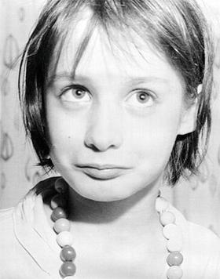
A case study Genie (feral child)
Genie (born 1957) is the pseudonym of an American feral child who was a victim of severe abuse ,neglect and social isolation.
When she was approximately 20 months old, her father began keeping her in a locked room.
During this period, he almost always strapped her into a child's toilet or bound her in a crib with her arms and legs immobilized, forbade anyone from interacting with her, provided her with almost no stimulation of any kind, and left her severely malnourished.

Slide 27
What have we learned from Genie Wiley?
Genie's story suggests that the acquisition of language has a critical period of development.
Her case is complex, however, since it is unclear if her language deficits were due to deprivation or if there was an underlying mental disability that played a role.
The severe abuse she experienced may have also affected her mental development and language acquisition.

Slide 28


